Slide 1

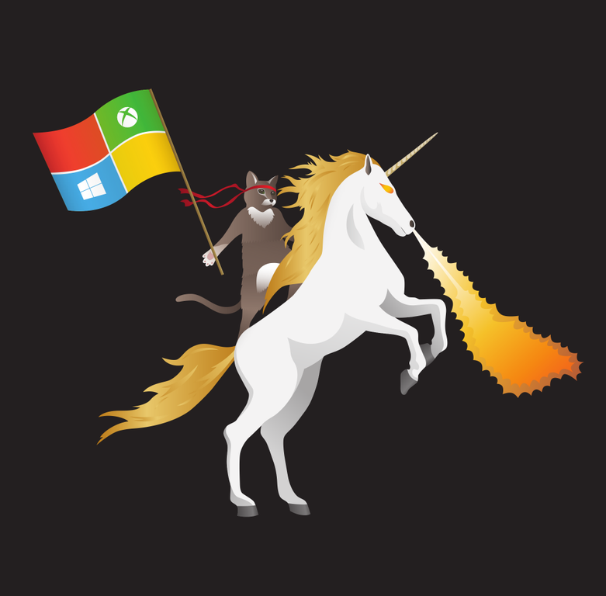




DevOps Journey at Overdrive - Experiences, Tips & Checklists From the Field DevOps
Slides: https://itproguru.com/Resources
Up tonight after dinner
Dan Stolts (@ITProGuru) Chief Technology Strategist US DX North East – Audience Blog: ITProGuru.com
dstolts@Microsoft.com
www.linkedin.com/in/danstolts
Specializations:
Cloud, Virtualization, Windows Server
Open Systems, Hybrid Cloud, Storage
aka.ms/70-534-book
@ITProGuru
Notes:
DevOps Journey at Overdrive - Experiences, Tips & Checklists From the Field DevOps
200
Learn how to put your DevOps journey into Overdrive. If you are not seeing amazing results every few weeks, you may not know how to get things moving at hyper-speed. ITProGuru will share tips, tricks, checklists, & examples to help make your journey fun, exciting and results driven FAST! There are many secrets to showing quick results. Results, where the true value of DevOps can be realized in just a few weeks. If you have not started the Journey, this is the place to start. If you already started but feel you should be able to get results faster, it is too hard, takes too long, or there is too much bureaucracy, this session will help. It will show how to kick your journey into high gear. Overdrive, is where you want to be, where you are executing at top speed with lower amounts of energy being consumed. Learn how to cruise with DevOps at this session. This session is driven by key components including: * Starting with the right discussions to have and with the right people * How to get the right people in the room - and consequences if you do not * Scheduling, preliminary discovery discussions, VSM and project hacking * Driving fun, passion and excitement fast * Results & Reporting * Repeat & Replicate All lessons will be leveraging field experience from Chief Technology Strategist Dan Stolts as he shares how he helped many customers begin or improve their Journey. Some of these experiences include very large companies that have been on their Journey for over a year with little to show for it. This will be a fast paced session where you will learn how to make DevOps fun, engaging and results driven. If you are serious about results, you will get some homework, checklists and presentation materials so you can make it all real for you! Don't miss this session as it could change your world. We will not have time to go deep into the VSM, which is critically important to fast success so look for Dan's other session on Value Stream Mapping.

Slide 2
DevOps Journey at Overdrive - Experiences, Tips & Checklists From the Field DevOps
Learn how to put your DevOps journey into Overdrive. If you are not seeing amazing results every few weeks, you may not know how to get things moving at hyper-speed. ITProGuru will share tips, tricks, checklists, & examples to help make your journey fun, exciting and results drive FAST! There are many secrets to showing quick results. Results, where the true value of DevOps can be realized in just a few weeks. If you have not started the Journey, this is the place to start. If you already started but feel you should be able to get results faster, it is too hard, takes too long, or there is too much bureaucracy, this session will help. It will show how to kick your journey into high gear. Overdrive, is where you want to be, where you are executing at top speed with lower amounts of energy being consumed. Learn how to cruise with DevOps at this session. This session is driven by key components including: * Starting with the right discussions to have and with the right people * How to get the right people in the room - and consequences if you do not * Scheduling, preliminary discovery discussions, VSM and project hacking * Driving fun, passion and excitement fast * Results & Reporting * Repeat & Replicate All lessons will be leveraging field experience from Chief Technology Strategist Dan Stolts as he shares how he helped many customers begin or improve their Journey. Some of these experiences include very large companies that have been on their Journey for over a year with little to show for it. This will be a fast paced session where you will learn how to make DevOps fun, engaging and results driven. If you are serious about results, you will get some homework, checklists and presentation materials so you can make it all real for you! Don't miss this session as it could change your world. We will not have time to go deep into the VSM, which is critically important to fast success so look for Dan's other session on Value Stream Mapping.

Slide 3
Kickstart Your DevOps Journey
Introductory Meeting [1.5 hours]
Quick review of pipeline: Feedback.. Production -> Planning/Ideation. This review will help us answer the following:
Identify primary tools, processes and perceived weaknesses if any
Define needed participants/roles to be included in VSM (and hack) - includes name, email address, tittle, role (Homework?).
Schedule VSM (Aug 31-Sept 1) & Hack October ????
If time, identify any training desired
VSM – Day 1-2
Around the room intro’s
Short DevOps Training
Whiteboard Value Stream Map
Working Lunch
Plan hack priority - {if needed}
Define Success
Identify expected outcomes
Homework – if needed
Lock hack dates
Training (Docker, VSTS, Azure, Hybrid, whatever) if needed and time permits
Hackfest
Day 1 - Setup Teams; Identify requirements, Identify scribe; Perform Training; Hack rest of day 😊
Day 2- Hack all day ☺ 3pm Team scrums
Day 3-? Hack all day ☺
Last Day
Morning Test process; tweak as needed
Document – outline will be provided; Teams can use to share their success with their leadership
Working Lunch
Afternoon Document; Create follow-up plan (future hacks, deploy in production, work on different part of pipeline, etc)
2:30-3:30pm; 10-15 mins team presentations to all hackers and Q&A from other hack teams
Provide Feedback using Event Feedback URL
Plan Project Phase II
Define Post hack Schedule
Leadership team discussions of projects and priorities
Plan continued hack schedule
4:30pm hack ends

Slide 4
Introduction Meeting Agenda
DevOps is for senior architects, developers, engineers and especially the Innovation, DevOps teams & leadership; Everyone enjoys the benefits – Dan Stolts
Introductions
DevOps… What is it; Results Driven Change (Culture + Digital Transformation)
Determine Objectives: eg. CI/CD Pipeline: Ideation/Planning -> Dev/Etc. -> Prod-> Feedback/Resolution.
Determined Shared Mission
Next Steps
Kickoff Meeting 1.5 hours
Value Stream Mapping (VSM) 1-2 days
Hackathon 4+ days
Followup - TBD
Who Should/Must Participate - need: name, email address, tittle, role
Schedule Kickoff
Who Participates…
DevOps Teams | Innovation Team | Management + Sr. Sponsor
Architects | Developers | Infrastructure
DBA | Networking | Security
QA/Release Management | Business Analyst | Partners
Other… Outsource Partners,
Role Responsibility (example CI/CD Pipeline)
Security - Incorporate security necessities into every aspect of the business; enable others to automate compliance
Development – Quickly build, deploy & update a product that our customers love; Enable other groups by building what they need to support you.
IS/IT – Build infrastructure as code; enable others by helping to eliminate waste throughout the technology landscape
Management – Enable the teams by giving them flexibility, guidance and support to do what is needed; remove obstacles
Senior Management – Embrace Cultural Change; Drive Transformation in the organization.
Sample Shared Mission: Deliver a great product that inspires our customers to become raving fans

Slide 5
Who Should/Must Attend/Participate
* Management / Sr. Management Sponsor
Architects
Business Analyst
DevOps Teams
Innovation Teams
Developers
Infrastructure
Networking
Security
DBA
QA
Release Management
Management
DevOps is for senior architects, developers and engineers as well as the Innovation and DevOps teams & leadership.
- Everyone enjoys the benefits
OR Else??

Slide 6
The right discussions with the right people Getting Started
Champion? (CIO, COO, Dev Manager, Innovations Manager, DevOps Manager, Director of IT, Other?
Discussion depends on Role
Objective: Fill a fundamental Need
Start with broad advantages
Significantly reduce cost of Application build and deployment
Shorten Development cycle by months
Increase Customer Satisfaction
Get cross functional teams working together
Increase technical staff skills
Ask probing questions
What are some of the biggest challenges you and your organization are facing now?
Drill down into the answers to find how DevOps helps solve those challenges

Slide 7






DevOps is the union of people, process, and tools to enable continuous delivery of value of our end uses.
DEV
OPS
1
People
2
Process
3
Tools
Shared Mission: Deliver a great product that inspires our customers to become raving fans
Notes:
People = Culture
Fundamental attributes of successful cultures:
Shared mission and incentives: infrastructure as code, apps as services, DevOps/all as teams
You need to consider your hardware as a commodity, (don't give your servers names) , servers are like farm animals, it is just harder if you let theids name them
Build deep instrumentation into services, push complexity up the stack
Rally around agile, shared metrics, CI, service owners on call, etc.
Changing the culture: any change takes time, changing culture is no exception and you can't do it alone, exploit compelling events to change culture: downtimes, cloud adoption, devops buzz
PROCESS Definition and design, compliance, and continuous improvement
PEOPLE Responsibilities, management, skills development, and discipline
Tools and infrastructure

Slide 8
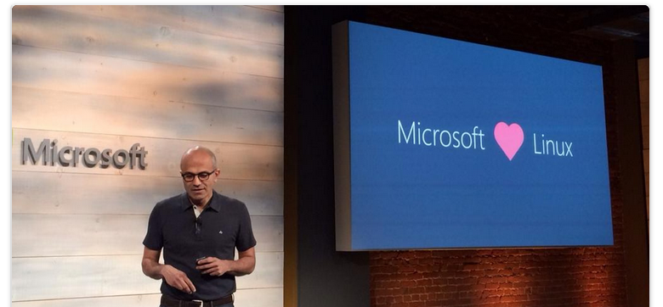
Culture Change & Digital Transformation

Slide 9
DevOps Practices
Primary
Secondary
Infrastructure as Code (IaC)
Continuous Integration
Automated Testing
Continuous Deployment
Release Management
App Performance Monitoring
Load Testing & Auto-Scale
Availability Monitoring
Change/Configuration Management
Feature Flags
Automated Environment De-Provisioning
Self Service Environments
Automated Recovery (Rollback & Roll-Forward)
Hypothesis Driven Development
Testing in Production
Fault Injection
Usage Monitoring/User Telemetry
http://www.itproguy.com/devops-practices/

Slide 10
Role of Security in DevOps aka DevSecOps
Incorporate security necessities into every aspect of the business; enable others to automate compliance
Making the business case:
GOVERNANCE
Security
Culture, politics, processes & laws that determine how a company should conduct itself.
Confidentiality
TRUST
Availability
Effect if uncertainty on organizational objectives.
Act of adhering & demonstrating adherence to laws, regulations, corporate policies & procedures.
Integrity
Privacy
COMPLIANCE
RISK
Help build a product that will inspire our customers to become raving fans

Slide 11
Roles and Responsibilities
Security - Incorporate security necessities into every aspect of the business; enable others to automate compliance
Development – Quickly build, deploy & update a product that our customers love; Enable other groups by building what they need to support you.
IS/IT – Build infrastructure as code; enable others by helping to eliminate waste throughout the technology landscape
Management – Enable the teams by giving them flexibility, guidance and support to do what is needed; remove obstacles
Senior Management – Embrace Cultural Change; Drive Transformation in the organization.
Everyone – Help build a product that will inspire our customers to become raving fans
Notes:
Security - Help find a way to incorporate security necessities into every aspect of the business; without getting in the way unnecessarily

Slide 12
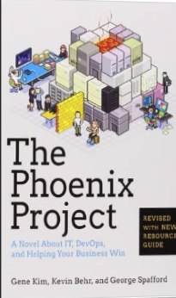
Tip: Must Read Book
Amazon…
The Phoenix Project: A Novel about IT, DevOps, and Helping Your Business Win Paperback
– October 16, 2014
The book is available on Audio Book; you can likely get it for free, if you do not already have an account. If you do not have an Audible Account, you get two free books when signing up for your free account.
This is the BEST IT Book I have ever read.

Slide 13
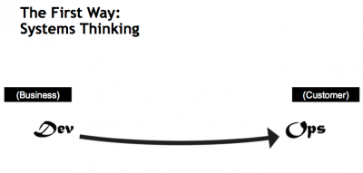
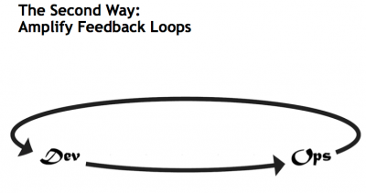
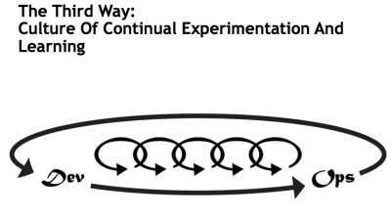
What is DevOps…
Infrastructure as Code (IaC)
Continuous Integration (CI)
Automated Testing
Application Performance Monitoring/Management (APM)
Continuous Deployment (CD)
Release Management
Configuration Management
DevOps Fundamentals
Advanced Monitoring
Capacity Management
Feature Flags
Self-Service Environments
Automated Recovery (Rollback & Roll-Forward)
Hypothesis Driven Development
Testing in Production – partial user base
Fault Injection
Usage Monitoring/Telemetry
A/B Testing (aka canary testing)
Gene Kim’s “3 ways”
The First Way emphasizes the performance of the entire system, as opposed to the performance of a specific silo of work or department — this as can be as large a division (e.g., Development or IT Operations) or as small as an individual contributor (e.g., a developer, system administrator).
The Second Way is about creating the right to left feedback loops. The goal of almost any process improvement initiative is to shorten and amplify feedback loops so necessary corrections can be continually made
The Third Way is about creating a culture that fosters two things: continual experimentation, taking risks and learning from failure; and understanding that repetition and practice is the prerequisite to mastery.
http://www.itproguy.com/devops-practices/
http://itrevolution.com/the-three-ways-principles-underpinning-devops/

Slide 14
Traditional vs modern dev-ops
Category | Traditional | Modern DevOps
Quality of code check-ins | Unknown | Validated through unit tests
Environment Creation/Configuration | Manual | Automated
Deployment Frequency | 1-2 months (or less frequent) | Deploy whenever needed, including several per day
App Deployment Process | Requires meetings and planning | Push-button deployment
Deployment validation | Manual | Automated
Monitoring | Minimal to none | Health and Performance monitoring
Dev and Ops relationship | Blame culture | Culture of trust

Slide 15
Tools: Containerization
ARM Template
2 Hosts
4 Instances of Container A
2 Instances of Container B
Container are… a technology that ENABLES and ACCELERATES DevOps
Abstract the unit of work from the VM
Lightweight, fast provisioning, density
Simplify application updates
Works with cluster managers for auto-scale capabilities
Container Host - 1
Container Host - 2
Container
A
Container
A
Container
A
Container
A
Container
B
Container
B
Orchestration Engine

Slide 16








Session VS VM (or VDI)
OS, Apps, Config, Mgmt
EACH Workload
Single OS
All Workloads
OS
OS
OS
OS
Apps
Apps
Apps
Apps
Massive VM Overhead
(Disk, Disk IO, Memory, CPU, OS, Licenses, Density, The works)
OS
OS
OS
OS
Apps
Apps
Apps
Apps
OS
OS
OS
OS
workloads
Apps
Apps
Apps
Apps
OS
OS
OS
OS
Apps
Apps
Apps
Apps
Application(s)
Application(s)
Operating
System
Operating
System
Parent OS
Hardware Virtualization
Hardware Virtualization
Hardware / Hypervisor Level
Session Based Computing
VM or VDI Based Computing

Slide 17


Containers
Single OS
All Workloads
OS
EACH Platform
App
App
App
App
App
App
App
App
App
App
App
App
App
App
App
App
App
App
App
App
App
App
App
App
All Advantages of VM & Session
Isolation, Little overhead
workloads
App
App
App
App
App
App
App
App
Container / Image
App
App
App
App
Container Engine
App
App
Linux VM
Container / Image
Container
Container
Application(s)
Container Engine
Container Engine
Operating
System
Operating
System
Parent OS
Hardware Virtualization
Hardware Virtualization
Hardware / Hypervisor Level
Container Based Density Advantages
Container Based Computing VM Isolation

Slide 18
Containers Deep Dive: Architecture of a Host
App
App
App
App
App
App
App
App
App
App
Copy on Write
Any layer that is SAVED or Downloaded is locked
Any workload
New Blank is created to allow write
Container Engine
Engine and Orchestration are different jobs, not always different products
Any workload can be set as a BASE by saving
It can then be used as a base, All required pieces below it will automatically be deployed
App
App
App
App
App
Web Sites
Web Site
Web App
App
App
Container Orchestration
Web Engine Config
IIS Config
Web Engine Config
Web Engine Base (IIS installed)
OS Base (eg. Nano)
Container Engine (Windows, Linux, Docker)
Operating
System
Hardware Virtualization

Slide 19
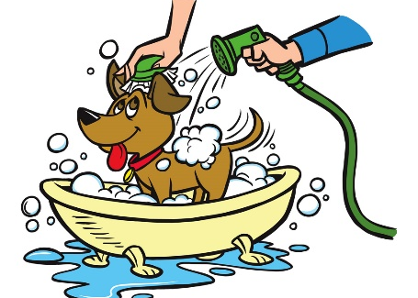

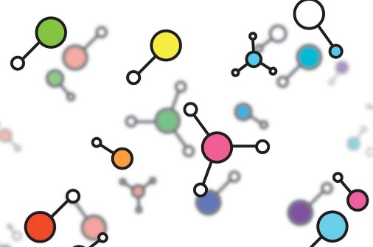


Cloud is a key enabler of DevOps – Agile & Functional a new way to think about a datacenter
I AM SPECIAL
WE ALL LOOK ALIKE
VIRTUAL
MACHINES
VM SCALE SETS
CONTAINER SERVICE
SERVICE FABRIC
Build on
Infrastructure Mindset
Build on
Platform Mindset
Ultimate Control
Traditional Model Cloud Model
Cost and Agility
System
Admin
Windows and Linux
.NET, Java, Python, PHP, Ruby, GO, Node.JS
Docker Swarm
Mesos, etc.,
Cloud Foundry,
Marathon, Deis, OpenShift etc.
Developer
Azure is Open at Every Layer
Notes:
Notes coming soon – please check back on http://aka.ms/opensource for latest version

Slide 20
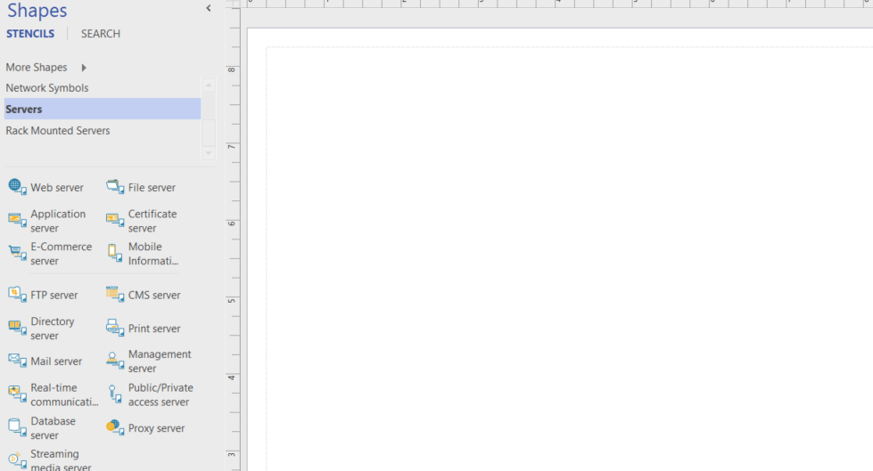
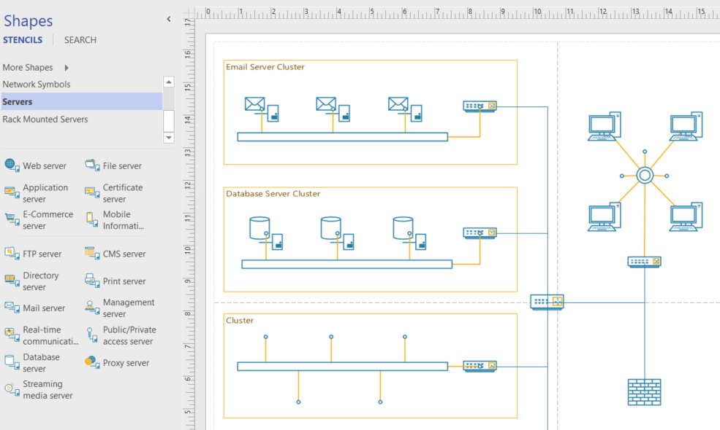
Azure..Like Visio, you start with a blank canvas…
Architect what is possible for your company. Solve Your Business Challenges with the Azure Cloud

Slide 21
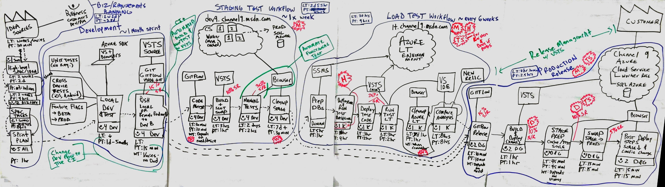
Value Stream Mapping
Analyze and Share “Waste”
Help to shorten the lead time
Value Stream Map の例

Slide 22
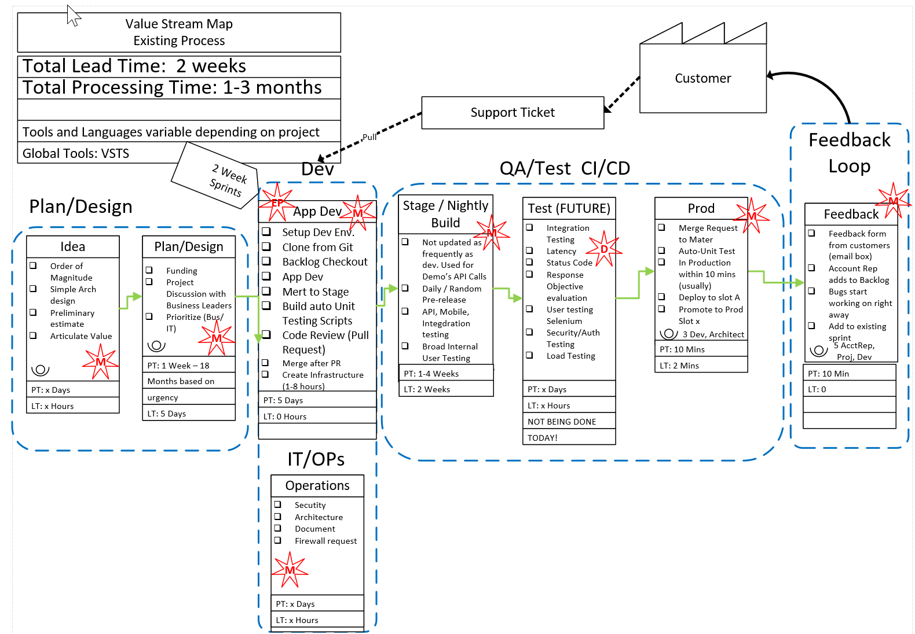
Before DevOps
How long does it take?
Where is the waste?
How much waste
Total time?
Homerun: Total Cost
2 Week Lead time
1-3 Months Processing
Waste in every step

Slide 23
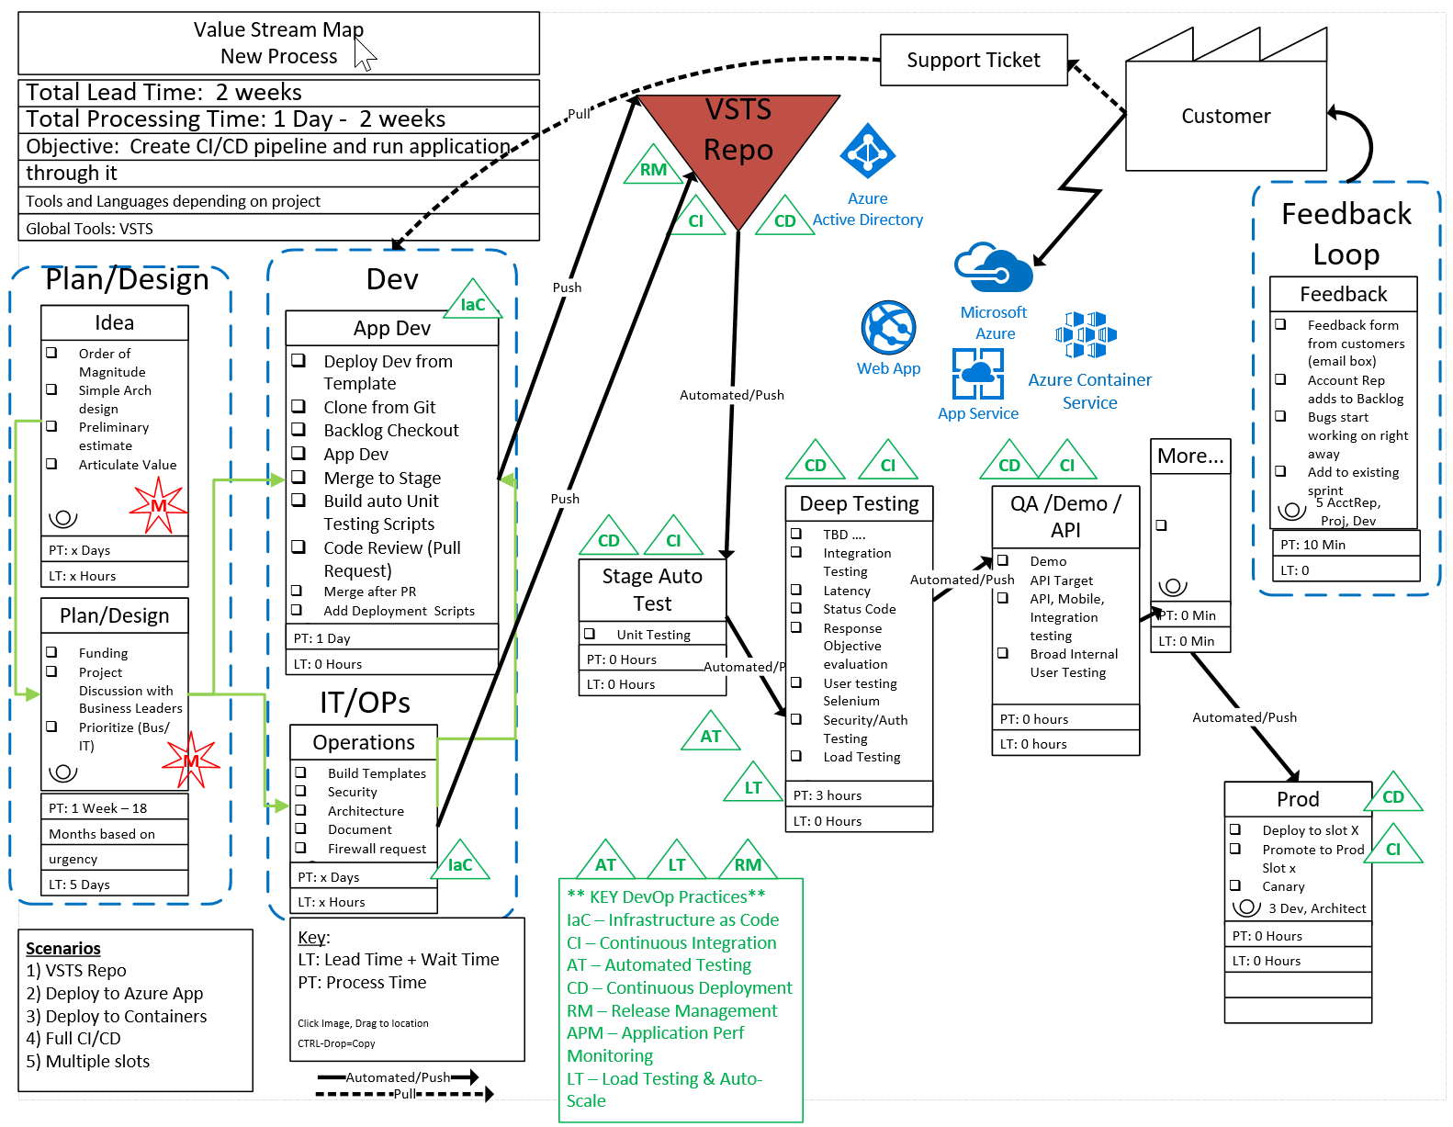
After DevOps
2 Week Lead time
1 Day – 2 Weeks processing time
Not all waste was cut in first pass
Fully automated and streamlined process with an application flowing through the system.
Investment: 3 weeks

Slide 24
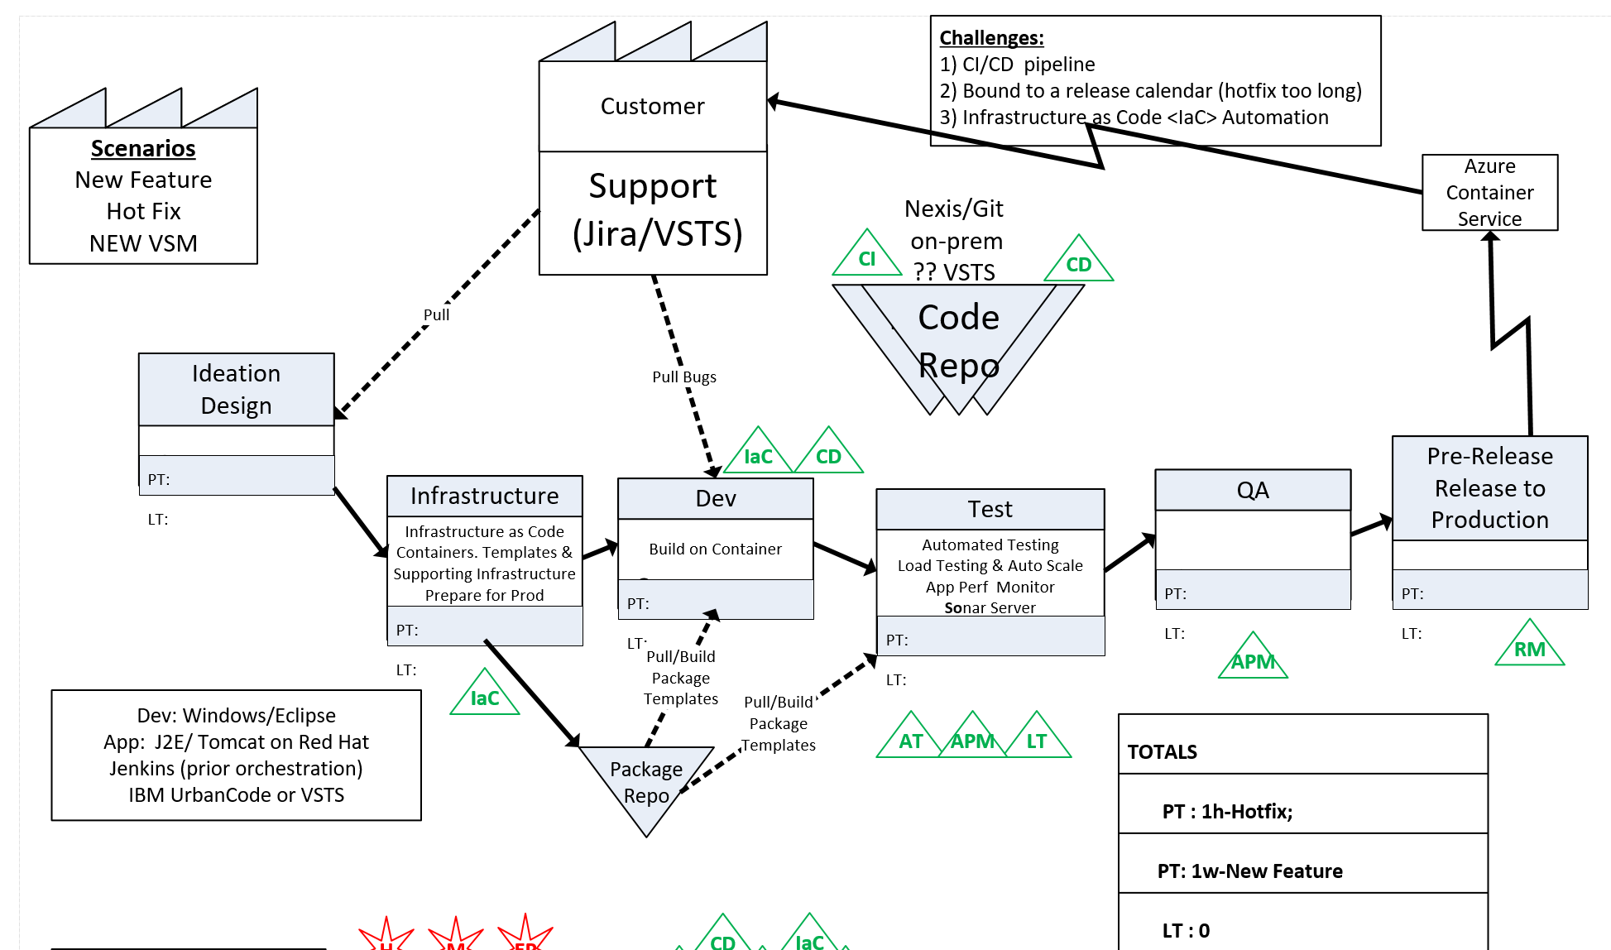
Release Cycle 18 months → 4 weeks Hotfix 6 week → Same Day Investment → 3 weeks

Slide 25
DevOps Kickoff Schedule
Introductory Meeting [1.5 hours]
Quick review of pipeline: Feedback.. Production -> Planning/Ideation. This review will help us answer the following:
Identify primary tools, processes and perceived weaknesses if any
Define needed participants/roles to be included in VSM (and hack) - includes name, email address, tittle, role (Homework?).
Schedule VSM (Aug 31-Sept 1) & Hack October ????
If time, identify any training desired
VSM – Day 1-2
Around the room intro’s
Short DevOps Training
Whiteboard Value Stream Map
Working Lunch
Plan hack priority - {if needed}
Define Success
Identify expected outcomes
Homework – if needed
Lock hack dates
Training (Docker, VSTS, Azure, Hybrid, whatever) if needed and time permits
Hackfest
Day 1 - Setup Teams; Identify requirements, Identify scribe; Perform Training; Hack rest of day 😊
Day 2- Hack all day ☺ 3pm Team scrums
Day 3-? Hack all day ☺
Last Day
Morning Test process; tweak as needed
Document – outline will be provided; Teams can use to share their success with their leadership
Working Lunch
Afternoon Document; Create follow-up plan (future hacks, deploy in production, work on different part of pipeline, etc)
2:30-3:30pm; 10-15 mins team presentations to all hackers and Q&A from other hack teams
Provide Feedback using Event Feedback URL
Plan Project Phase II
Define Post hack Schedule
Leadership team discussions of projects and priorities
Plan continued hack schedule
4:30pm hack ends

Slide 26
HACK
* Driving fun, passion and excitement fast * Results & Reporting * Repeat & Replicate

Slide 27
Post Hack

Slide 28
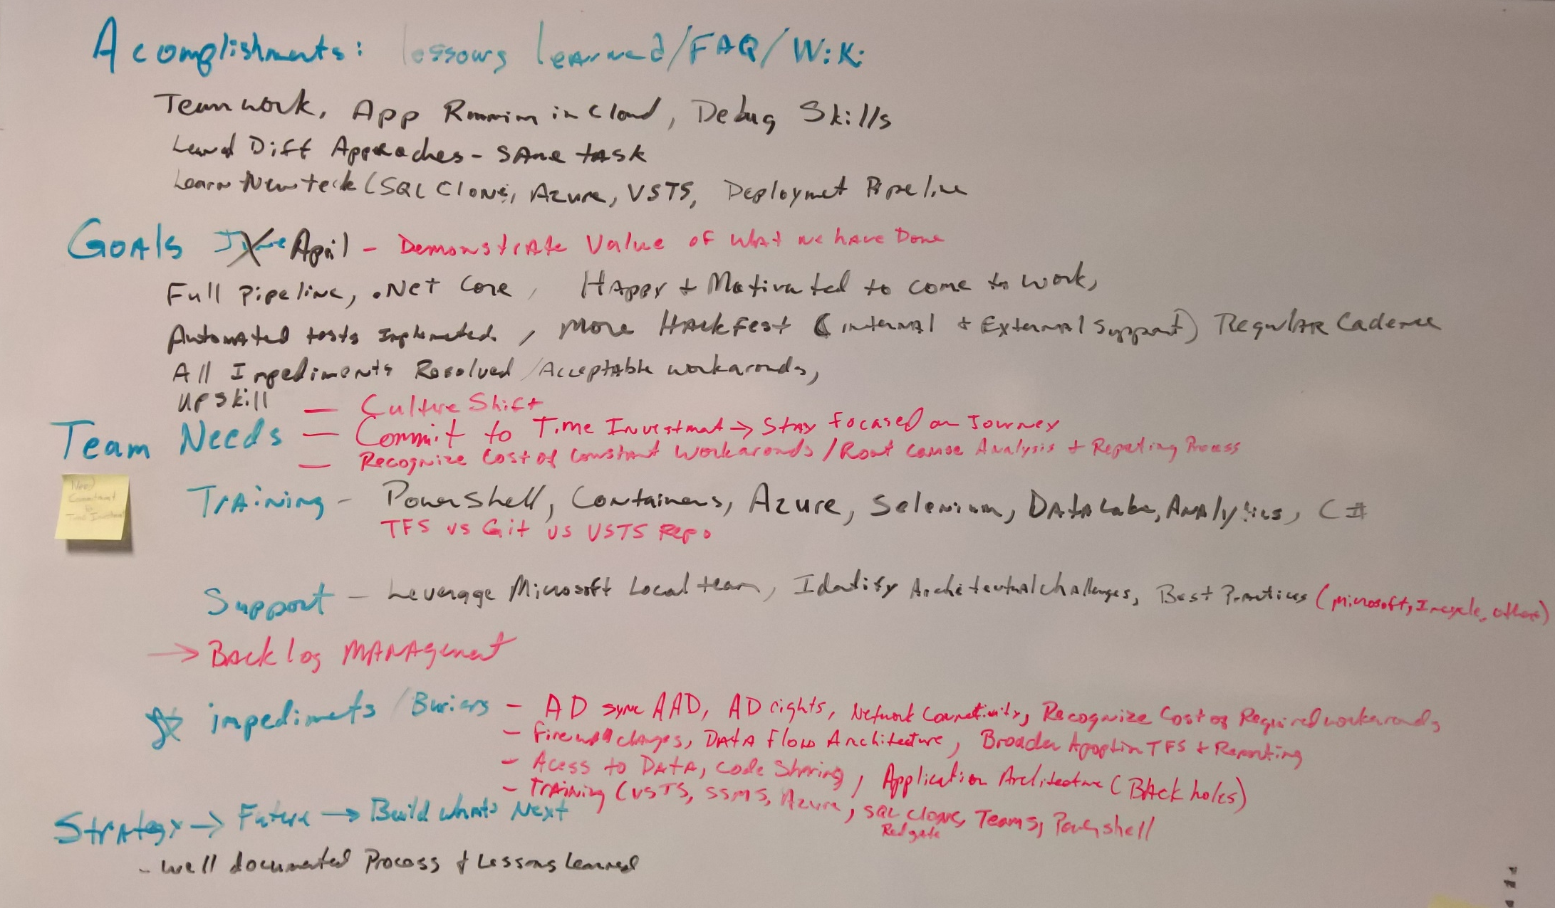
End of Event Brainstorming
Accomplishments
Goals
Team Needs
Training
Support
Imediments
Strategy
Future
Build What’s Next

Slide 29
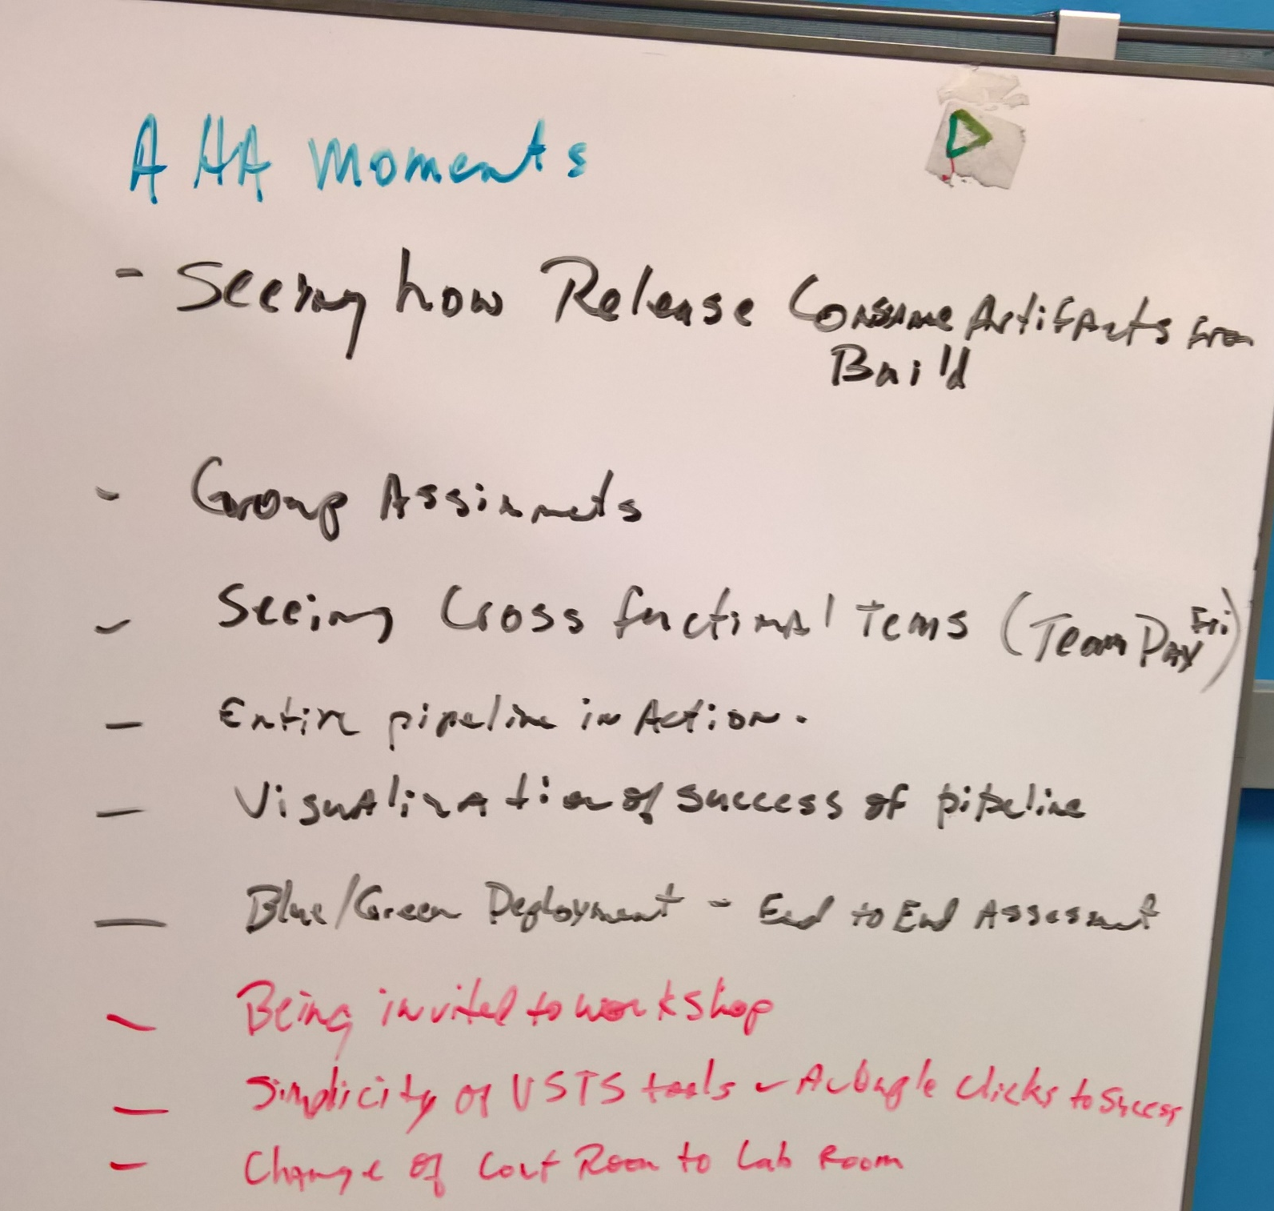
Brainstorming: AHA Moments
When did it click for you that his is a significant game changer?

Slide 30
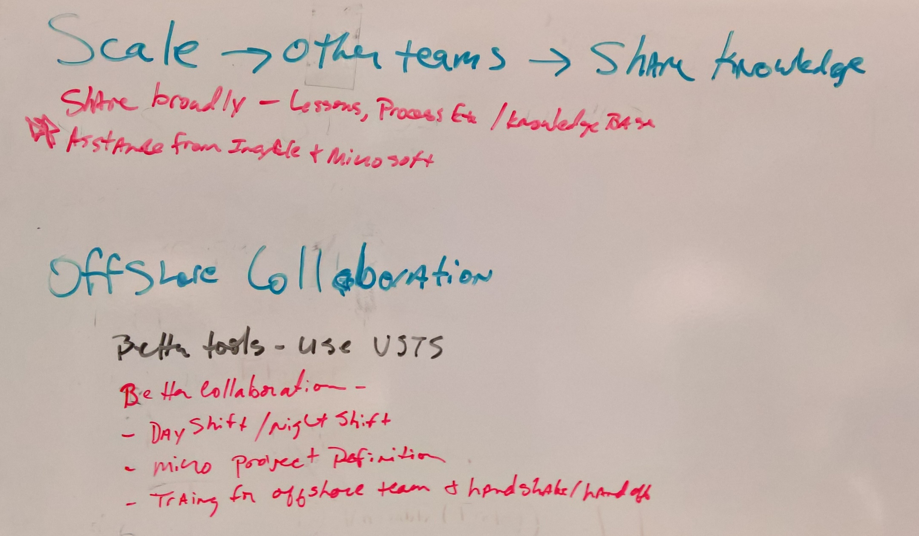
Brainstorming: Scale and Offshore Collaboration

Slide 31
End of Event Report
Scrum
Executive Report
Detailed Report
Accomplishments
Value (Quantify with $ if possible)
Next Steps
Blockers to be addressed (and who is responsible)
What has changed organizationally
What new capabilities or efficiencies have been gained
Next Hackathon Date

Slide 32
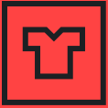
Azure Red Shirt Dev Tour ‘17
Whether you’re new to the cloud or a seasoned expert, you’ll learn something at the Azure Red Shirt Dev Tour ‘17. The Red Shirt Tour is all about code. Join Microsoft’s cloud chief, Scott Guthrie, as he codes live and demonstrates how Azure can help you solve some of your most vexing developer problems.
New York | October 20 | Register today @ aka.ms/newyorkrst

Slide 33

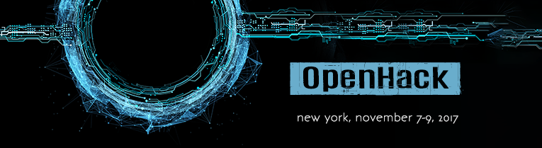
Register: https://aka.ms/OpenHackNYC
Join us for three days of fun-filled, hands-on hacking where you will team up with community peers and learn how to take Linux and Windows based workloads to the cloud. During OpenHack you will:
Choose your desired tooling and technology based on either Kubernetes or Azure Service Fabric paths.
Hack on increasingly robust challenges structured to leave you with skills and expertise needed to deploy containers and clusters in your place of work.
Network with fellow community members and other professional developers from startups to large enterprises, as well Microsoft Engineering leaders and experts including Gabe Monroy (former Founder & CTO of Deis and Engineering Lead for Azure containers) and Mark Fussell (Engineering Lead for Azure Service Fabric).
Get answers to your technology and workplace project questions from Microsoft and community experts.
To be successful and maximize value from the event, participants should establish a basic understanding of the following concepts and technologies. You are not required to be an experienced expert or authority, but a familiarity with each will be advantageous:
Docker Containers
Cloud hosted services
REST Services
DevOps
IP Networking & Routing
Register: https://aka.ms/OpenHackNYC

Slide 34
Free Resources for DevOps Practices
Optimize your DevOps practices & tools:
Get started on your DevOps journey: aka.ms/devops
Download the Forrester Infrastructure-as-Code whitepaper:
Complexity kills. Automate with Infra as code: aka.ms/iac_tlp
Accelerate your application delivery lifecycle
Technical resources for Practitioners:
Get access to free online training, evals and HOLs: aka.ms/devopsmva
Join the Community conversations:
Use #TalkDevOps on Twitter

Slide 35



TechNet Virtual Labs
Deep technical content and free product evaluations
Hands-on deep technical labs
Free, online, technical courses
At the TechNet Evaluation Center you can download free, trial versions of Microsoft software, with no feature limits. Dozens of trials are available – all at no cost.
Try Windows Server 2012 R2 for up to 180 days. Download the Windows 8.1 Enterprise 90-day evaluation. Or try Microsoft Azure at no-cost for up to 90 days.
Microsoft Hands On Labs offer virtual environments that will take you through guided, technically deep product learning experience.
Learn at your own pace in labs that you can complete in 90 minutes or less. There is no complex setup or installation is required to use TechNet Virtual Labs.
Microsoft Virtual Academy provides free online training on the IT scenarios that are important to your company and your career.
Learn at your own pace and boost your IT skills with over 100 courses across more than 15 Microsoft technologies including Windows Server, Windows 8, Microsoft Azure, Office 365, virtualization, Windows Phone, and more.
Download Microsoft software trials today.
Find Hand On Labs.
Take a free online course.
Technet.microsoft.com/evalcenter
Technet.microsoft.com/virtuallabs
microsoftvirtualacademy.com

Slide 36
More Resources
Resource | Link
Virtual Academy Videos | https://mva.microsoft.com/product-training/microsoft-azure#!jobf=IT%20Pros&lang=1033
Various On-line training | https://www.microsoft.com/en-us/learning/azure-training.aspx
Visual Studio Developer Incentives | https://www.visualstudio.com/dev-essentials/
Azure training for AWS professionals | https://openedx.microsoft.com/courses/course-v1%3AMicrosoft%2BAzure213x%2B2016_T4/
Microsoft Azure for IT Pros Content Series | https://mva.microsoft.com/search/SearchResults.aspx#!q=Microsoft%20Azure%20for%20IT%20Pros%20content%20series&lang=1033
LinkedIn Learning Center | https://learning.linkedin.com/in/overview
Microsoft Learning
https://www.microsoft.com/en-us/learning/default.aspx

Slide 37
Questions… Answered at Events
?
?
?
?
?
?
?
?
?
?
?
?
?
?
?
?
?
?
?
?
?
ITProGuru.com/Join

